Slide 1
LOW POWER EMBEDDED SYSTEMS

Slide 2
Need to reduce power dissipation
Power dissipation affects:
Performance
Reliability
Packaging
Cost
Portability

Slide 3
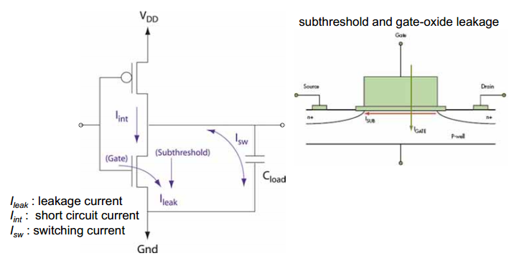
Dynamic power
Today’s most microcontroller are fabricated using CMOS technology. For example, consider a simple CMOS inverter

Slide 4
CMOS inverter example
It consumes little to no power when the input is at VDD or VSS (i.e. when it off or on)
However, when there is a transition from VDD to VSS, there is the CMOS transistor is shortly biased in a linear mode. In this case, the current IC is substantial and the power loss is high.
Additionally, in real system, there is a load capacitor on the output bus. This capacitor requires additional current (hence additional power consumption) associated with charging and discharging of capacitor when the logic level changes.

Slide 5
Power Dissipation Components in CMOS Circuits
Dynamic
Signal transitions (charging and discharging of load capacitance)
Logic activity
Glitches
Short-circuit (direct current from Vdd to GND when both PMOS and NMOS networks are on)
Static
Leakage: when input is not switching.
P_{total} = P_{dyn} + P_{stat}
= P_{tran} + P_{sc} + P_{stat}

Slide 6
Static Power
Static Power Consumption
Static current does exist in CMOS as long at input voltage is less than the threshold of the NMOS transistor (V_{in} < V_{TN} ) or greater than the threshold voltage of the PMOS added to the power supply voltage (V_{in} > V_{DD}+V_{TP})
Leakage current is determined by the transistor which is cut-off
Determined by the W/L values of the transistor, supply voltage, and threshold voltages
V_{DD}
V_{DD}
I_{leak,p}
V_{I}<V_{TN}
Vcc
V_{DD}
Vo(low)
I_{leak,n}

Slide 7
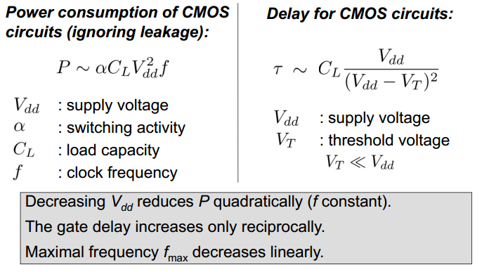
DYNAMIC POWER CONSUMPTION
The average power consumed by dynamic switching losses of a single gate can be defined by the following equation:
Note that this equation is for a single CMOS device, not the entire MCU. When considering the entire MCU, this equation will be multiplied by a scaling factor (a), which varies depending on the switching frequency of all of the gates in the device.

Slide 8
Short Circuit Power
V_{DD}
V_{DD}
I_{max}
i_{sc}(t)
v_{i} (t)
v_{o}(t)
I_{D}
V_{o}
C_{L}
Ground
V_{i}
V_{DD}
Short circuit current flows during the brief transient when the pull down and pull up devices both conduct at the same time where one (or both) of the devices are in saturation

Slide 9
Power Dissipation in CMOS Circuits
Total power consumption
P_{tot}=P_{dynamic}+P_{Short}+P_{stat}
Dynamic power
(≈ 40 - 70% today and decreasing relatively)
Short-circuit power
(≈ 10 % today and decreasing absolutely)
Leakage power
(≈ 20 – 50 % today and increasing)

Slide 10
Reducing Power
Reducing dynamic capacitive power:
Lower the voltage
Quadratic effect on dynamic power
Reduce capacitance
Short interconnect lengths
Drive small gate load (small gates, small fan-out)
Reduce frequency
Lower clock frequency
Lower signal activity (alpha)
Reducing short-circuit current:
Fast rise/fall times on input signal
Reduce input capacitance
Insert small buffers to “clean up” slow input signals before sending to large gate
Reducing leakage current:
Small transistors (leakage proportional to width)
Lower voltage

Slide 11
Reducing the α(activity factor)
If a circuit can be turning off entirely, the activity factor and the dynamic power → 0
Blocks are typically turned off by stopping the clock which is called clock gating
When a component is on, the activity factor is 1 for clocks and substantially lower for nodes in logic circuits
If the signal switches once per cycle, α=1/2
Dynamic gates switch either zero or twice per cycle: α=1/2
Static gates switch depending on their design, but typically α=0.1

Slide 12
How to reduce dynamic power consumption?
Voltage is the most significant factor in dynamic power consumption because the voltage term is squared. Reducing the system operating voltage will have a significant impact on power consumption.
Another major consideration is which of these components can be modified in a system. Every embedded system has different requirements which will limit the ability of a designer to adjust the voltage, frequency or load capacitance.
For example, the embedded system designer has limited control over C, the internal load capacitance. The capacitance is a function of the internal MCU lay-out and design. It is up to the MCU manufacturer to limit the switching of load capacitance by utilizing proper low-power IC design techniques. The only control the system designer has over internal load capacitance is the ability to enable and disable MCU features individually.
A savvy low-power designer should ensure that, at any point in a program, only the currently needed features of the MCU are enabled and all others are turned off

Slide 13
How to reduce dynamic power?
A designer does have control over the external load capacitance of a signal that is routed to an I/O pin. These capacitances can be much larger than the internal capacitance of the device and can cause significant losses. For this reason, it is important for a designer to review a design for stray capacitance on digital switching
Operating voltage is primarily defined by the process technology used in the manufacture of the MCU. As process geometries shrink, the operating voltage decreases and the device consumes lower dynamic power. An embedded system designer can utilize this knowledge by selecting MCUs which are capable of operating at lower voltages. However, if the minimum system voltage is defined by some other component of the system, such as a sensor or communications interface, this will require a cost versus power trade-off. This would require an additional voltage regulator for the MCU power, which would increase system cost.

Slide 14
Reducing Capacitance
Capacitance from switching is a result of wire lengths and transistors in a circuit.
Wire capacitance can be minimized through component floor planning and placement (locality of a structured design)
Units who exchange large amounts of data should be placed next to one another to reduce wire lengths
Device level switching is reduced by choosing fewer stages of logic and smaller transistors.

Slide 15
Reducing Capacitance
Gates that are large and/or have a high activity factor have a large amount of power consumption, can be downsized with only a small performance impact .
Example: Buffers driving I/O or long wires may use 8-12 stages to reduce the buffer size.
Wire capacitance dominates many circuits
There are no closed form methods to determine gate sizes that minimize energy under a delay constraint.

Slide 16
Voltage
Voltage has a quadratic effect on dynamic power, therefore choosing a lower supply significantly reduce power consumption (lowering vdd by ½ can lead to a savings of ¼ dynamic power)
Chip can be partitioned into multiple voltage domains optimized for a specific needs. (memory cells can use high voltage for stability, medium voltage for processors, and low voltage for I/O peripherals)
Sleep mode turns off voltage domains entirely saving leakage power
Different operating modes can adjust voltage operation (laptop operating on AC adapter vs. battery)
If frequency and voltage scale down in proportion, a cubic power reduction can be achieved.

Slide 17
Frequency and Short-Circuit Current
Dynamic power is directly proportional to frequency, so a chip should not run faster than necessary
Reducing the frequency also allows downsizing transistors or using a lower supply voltage
Larger output load capacitance reduces short-circuit power dissipation because with a larger load, the output switches a small amount during the input transition (gate output transition should not be faster than the input transition). The larger capacitor takes most of the current.
Short circuit power is about 5-10% of dynamic power and can be ignored in hand calculations

Slide 18
Reducing Standby Current
Because RAM is usually preserved in sleep mode, a processor with a smaller RAM may be more power friendly than a larger one. Thus turn off RAM hungry components if you don’t need them
Use a zero standby power, which usually means a small mechanical on/off switch. That’s a very good solution, but users hate it since they will need to turn on and off a device manually before use.
The best way to implement a real “zero-power” mode is using one of the device’s buttons as a hard-wired power on.

Slide 19
SUMMARY – HOW TO REDUCE POWER?
Turn off components that are not needed. The downside is that those components won't be ready when you need them, and bringing them back will add both some power usage and some latency in responding to events.
Turn off peripherals (RAM, ADC, ICs…) that are not needed.
Turn Off Unused I/O devices. If you've got spare I/O devices, you can save a little bit of current by configuring them to be inputs with internal pull-downs.
Slowing Down to Conserve Energy: Lowering your clock frequency saves power. But also the CPU is slower! In some cases, it may be optimal to run at a higher frequency and finish an operation more quickly to allow the system to return to Sleep for minimal power use
Putting the Processor to Sleep

Slide 20
SUMMARY – HOW TO REDUCE POWER?
Putting the Processor to Sleep: On your computer, sleep is a standby mode where processing is off but the memory is still powered:
Slow down: Going beyond frequency scaling, some processors allow you to slow the clock down to hundreds of hertz.
Idle or sleep: This turns off the processor core but keeps enabled timers, peripherals and RAM alive. Any interrupt can return the processor to normal running
Deep sleep or light hibernation: In addition to the processor core being disabled, some (possibly all) peripherals can be configured to turn off. Be careful not to turn off the subsystem that generates the interrupt that will wake up the processor.
Deep hibernation or power down: The processor chooses which peripherals to be turned off (usually almost all of them). RAM is usually left in an unstable state, but the processor registers are retained, so the system doesn't need initialization on boot. Usually, only a wakeup pin or a small subset of interrupts can restart the processor.

Slide 21
HARDWARE DESIGN CONSIDERATIONS
Board Level Considerations
Maximize impedance in current paths
Minimize impedance in high-speed switching paths
Minimize leakage currents
Minimize operating duty cycles

Slide 22
HARDWARE DESIGN CONSIDERATIONS
PUSH BUTTON
Increasing the value of the pull-up can help to reduce power, but at high resistances, may reduce noise immunity. Additionally, increasing the size of the pull-up increases the time constant of the signal, which increases the rise time before high voltage is detected.
A better method is to use the MCU’s internal pull-up resistors as the voltage source for a push button. Because the internal pull-up can be enabled and disabled, dynamically in code, as soon as the button press is detected, the MCU can disable the pull-up, removing the current path to ground.

Slide 23
HARDWARE DESIGN CONSIDERATIONS
LEDs:
Drive the LED at a lower duty cycle using a PWM. This gives the code some degree of control over the LED power consumption by being able to dynamically reduce the brightness, if necessary.
Drive the LED at lower current levels by increasing the size of the current-limiting resistor.

